Slide 1

DriverPass System Analysis
Tyler Ellis
Notes:
[No speaker notes required for this slide.]

Slide 2

System Requirements
Secure user access with different roles
Scheduling system for driving lessons
Integration with DMV updates
Online classes and practice tests
Notes:
[In your speaker notes, include an explanation of the different requirements you determined for DriverPass’s system. What are the functional requirements you selected to describe? What are the nonfunctional requirements you selected to describe? Be sure to explain how these requirements meet DriverPass’s needs.]

Slide 3
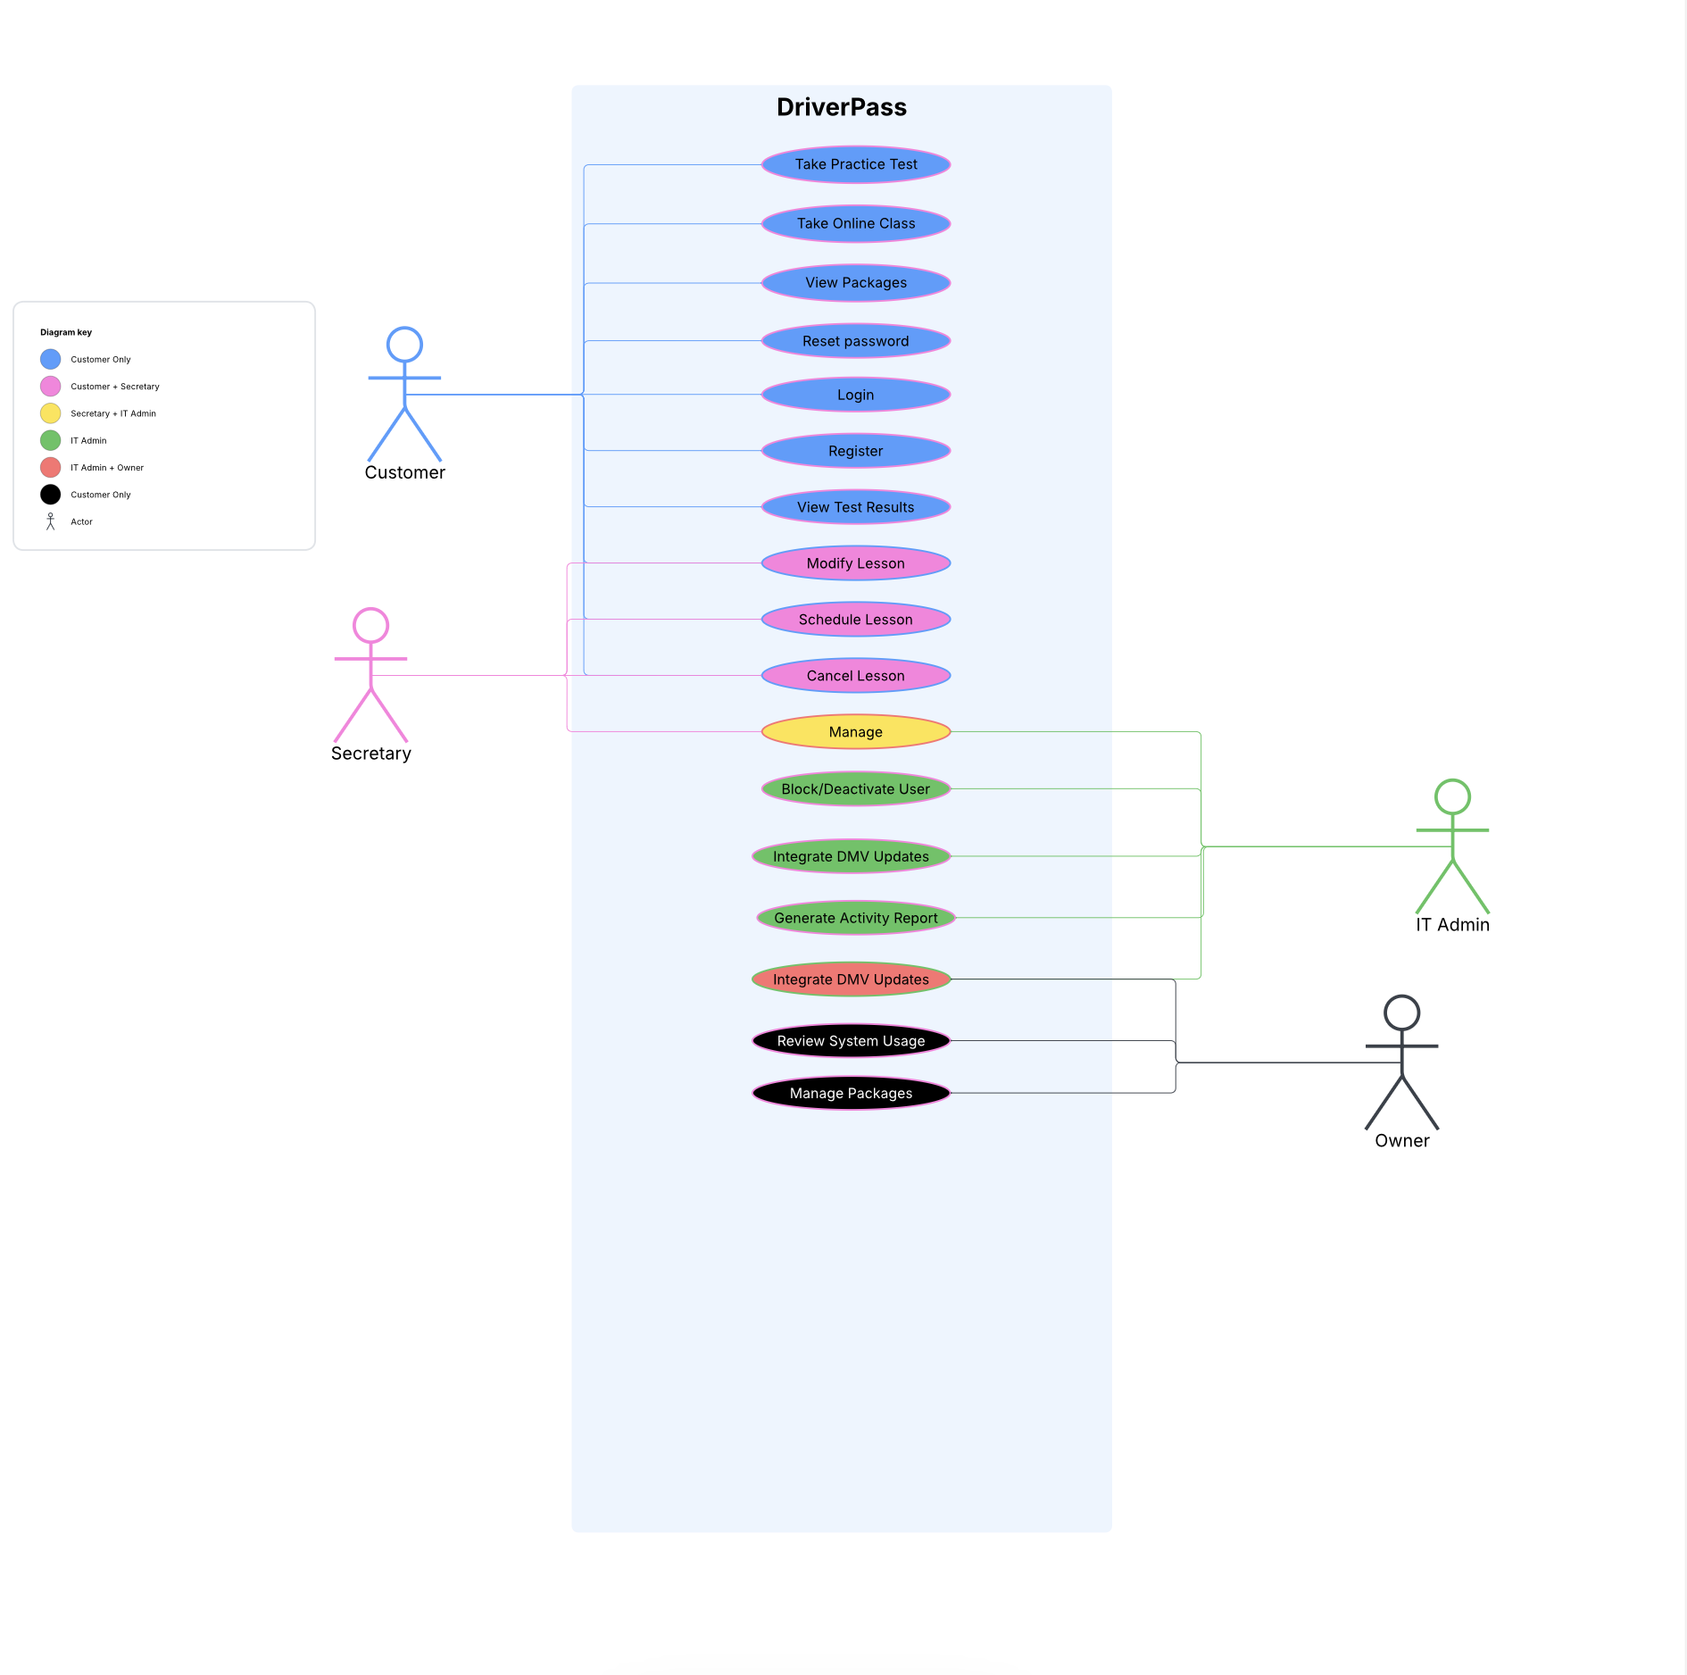
Use Case Diagram
Notes:
[Explain your diagram. Who are the different actors in the system? What are the different use cases? How did you account for DriverPass’s needs in your design? In your explanation, keep your audience in mind. Avoid the use of terms like “actors” and “use cases” in your explanation.]

Slide 4
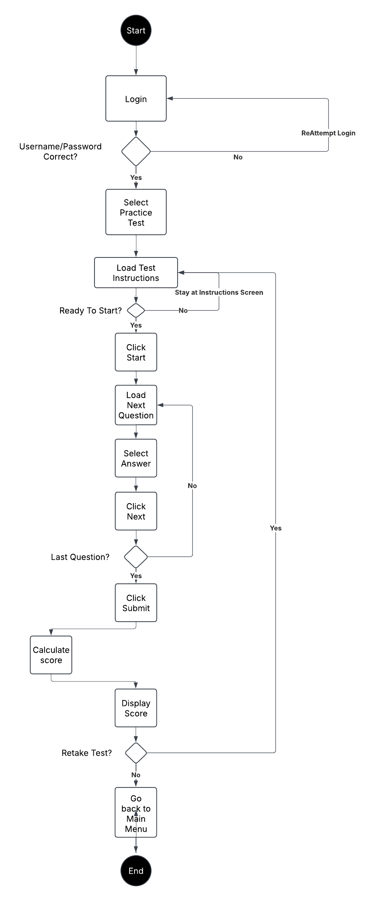
Activity Diagram
Notes:
[Explain your diagram. Which use case are you breaking down? What are the steps for this use case? How did you account for DriverPass’s needs in your design? In your explanation, keep your audience in mind. Avoid the use of technical terms such as “nodes,” “control flows,” and so on.]

Slide 5
Security
HTTPS/TLS encryption
Role-based permissions
Brute force lockout
Regular patches and updates
Notes:
[How did you consider security in your design? In your explanation, keep your audience in mind by avoiding the use of technical terms.]

Slide 6
System Limitations
Online-only data modification
Dependent on DMV services
Package customization needs developer support
Notes:
[What are the limitations of your design? In your explanation, keep your audience in mind by avoiding the use of technical terms.]

